Slide 1

Poornima
Institute of Engineering and Technology
Convergence, 2021
_______________
International Conference
on smart Innovations for Society (ICSIS-2021)

Slide 2
Paper Title: Because Every Drop Have Life Blood donation to fight against the Crisis of blood in future
Paper id: 61
Author;
Kishan Kumar
Kumari Khushboo
Ishu Kumar
Presenter name:
Kishan Kumar
Kumari Khushboo
Ishu Kumar

Slide 3
CONTENTS
1. Object of the paper
2. introduction
3. Decrease in blood donation During Lockdown
4. Myths that keep one from Donating Blood
5. Benefit of Blood Donation Some side effect of blood donation:
6. who can or can’t donate blood
7. Maintain safety for the donor
6. Tips for successful blood donation: Before donation
7. Conclusions

Slide 4

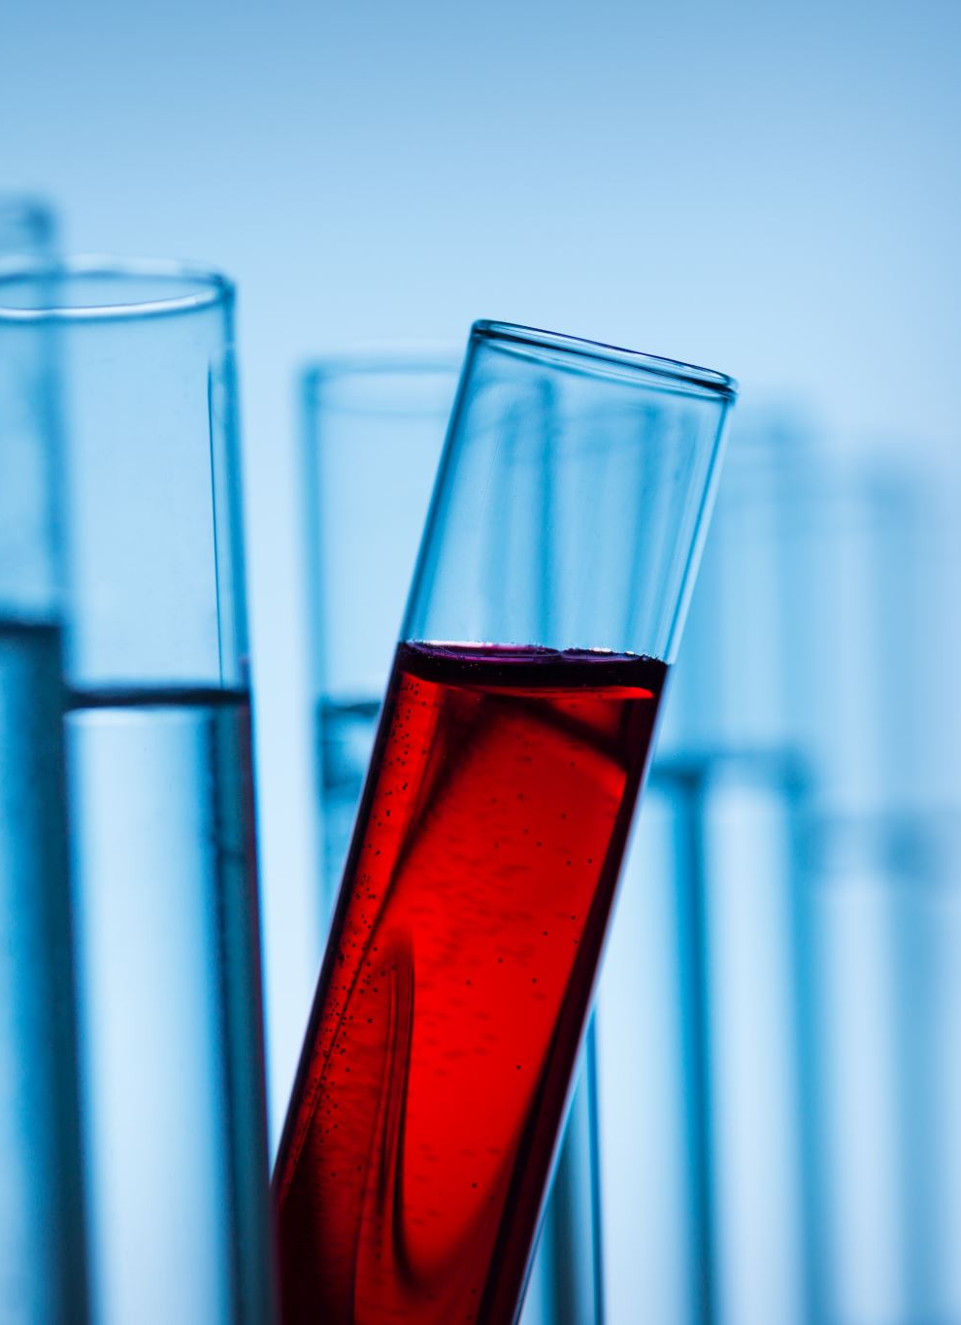
Objective Of Paper
The objective of this paper is to study about blood donation.
Blood donation refers to the process of collecting, testing, preparing, and storing blood and blood components.
To sensitize the need of donating blood to the needy in time.
To instil the feeling of helping others to breathe life with their precious donation.
To motivate all students to take a pledge to donate blood at least once in a year.
To impart to them the value of blood donation.
To aware of the scientific information about the blood group .
To About making the government a right arrangement.

Slide 5
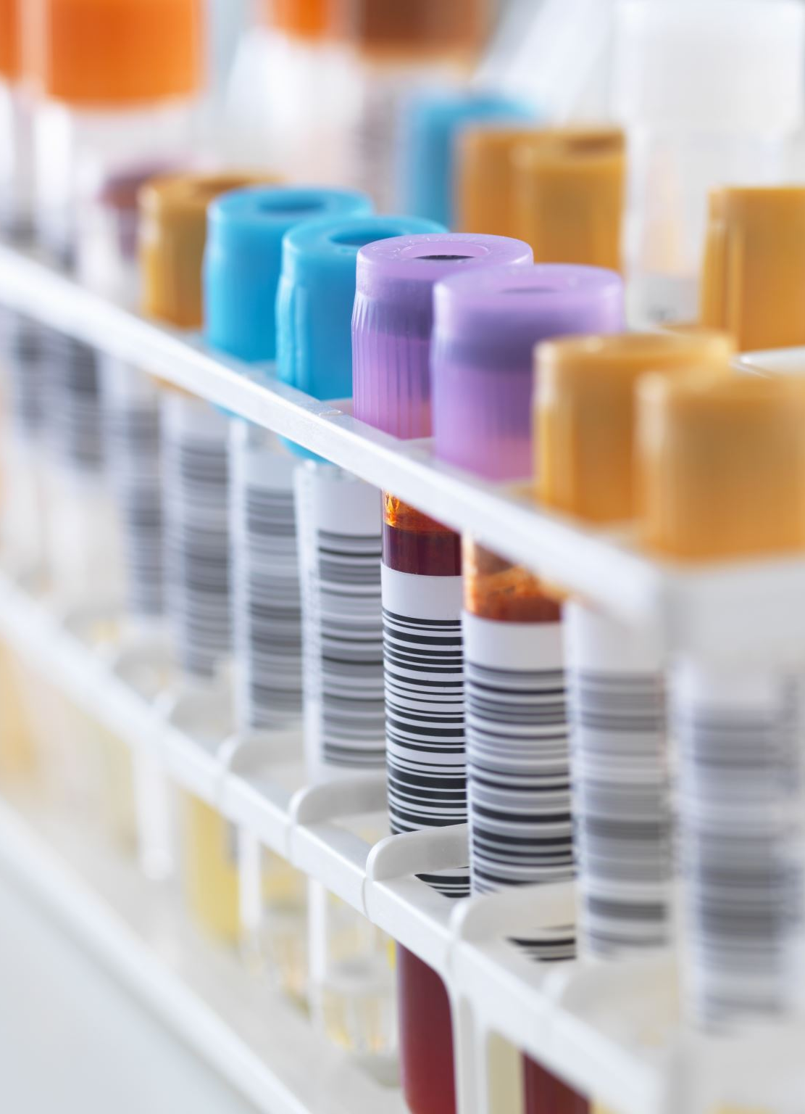
Introduction:
What is blood donation?
A man can’t survive without blood. Research work is carried on across the world to find a suitable substitute for blood. Due to shortage of blood in covid-19 research is carried out on Artificial blood. But so long as blood can’t be replaced by artificial blood or a suitable one
What are the types of blood groups;
The group of blood is very important to know.
The blood is divided into four groups, there are A, B, AB and O. Those are sub divided into positive and negative groups.

Slide 6

Decrease in blood donation During Lockdown
During lockdown, it found that the decrease in blood donation. we can better understand why there are too many decrements in blood donation during lockdown with the help of the following factor.
Restrictions on mobility
lack of information
Increased isolation
Fear
Perfect online platform is not available
Due to transporting system

Slide 7
Myths that keep one from Donating Blood
Benefit of Blood Donation
Helpful for health.
One unit of blood from your donation can save 3-person lives.
Help to reduce heat issues.
Regular blood donation helps to control iron in the body.
After donation, new blood cells.
help to reduce stress.
help to get out of negative feelings
Myth#1 It causes fatigue Reality: Donors are given refreshment soon after. One can resume work after an hour | Myth#2 It reduces blood in the body. Reality: Around one pint is taken. An adult has 8-12 pint of blood | Myth#3 Blood Donation is a painful process Reality: only pain is of the needle pricking the skin

Slide 8
Some side effect of blood donation
There is no confusion, donating blood is good for health. WHO report say that it help our body to restart but sometimes there is a little side effect are reported after donation are the following
1. Injury: when a doctor removes the needle from the vein there is always a chance to get injury wherever the needle gets injected.
2. keep on bleeding: sometimes after removing the needle from the vein the bleeding keeps on and stops after 4 to 5 hours.
3. Dizziness, lightheadedness, and nausea
4. pain
5. physical weakness

Slide 9
who can or can’t donate blood
1. Less than 18 or older than 65 can’t donate blood.
2. Who has a fever, cold cough and can't donate blood?
3. Diabetes people who use injections can’t donate blood. Those people who maintain diabetes with diet or oral medicine can donate.
4. Weight should be 45kg or more than 45kg.
5. Haemoglobin level is not more than 12-50gm.
6. Donors don’t have any infection.
7. After taking the vaccination you cannot donate blood after 14 days. Those people who recover from covid-19 donate blood after 28 days.
8. Women donate after 1 year of delivery, when she stops breastfeeding.

Slide 10
Tips for successful blood donation:
Before donation:
Eat healthy
Avoid Fatty Food
Eat at least 4 hours before donation
Take a good sleep
Take extra water
Remember to carry your id card
Don't drink or smoke before 24 hours
After donation:
Drink lots of fluids
Do not consume alcohol and don’t smoke
Don’t lift heavy object
Don’t exercise
Eat iron and vitamin enriched food
If there is prolonged bleeding or you feel dizzy and nauseous, consult a doctor

Slide 11
Maintain safety for the donor
In the time covid-19 the government should thought about the safety of donor and have the proper data like
Free health checkup
1. Travel history
2. contact history
3. social distance maintain in the camp or hospital
4. cleanness
5. everyone wear mask and gloves
6. proper use of sanitizer
When you are visiting to donate your blood. Firstly you go through health screening. Where doctors check yours
pulse .
blood pressure .
body temperature .
hemoglobin level .
covid test

Slide 12
Tips for successful blood donation:
Before donation:
Eat healthy
Avoid Fatty Food
Eat at least 4 hours before donation
Take a good sleep
Take extra water
Remember to carry your id card
Don't drink or smoke before 24 hours
After donation:
Drink lots of fluids
Do not consume alcohol and don’t smoke
Don’t lift heavy object
Don’t exercise
Eat iron and vitamin enriched food
If there is prolonged bleeding or you feel dizzy and nauseous, consult a doctor

Slide 13
Conclusions:
Let there be blood crises in the future so we need to pay attention to the coming situation. Everyone needs to blood contribution. A recent study shows a decrease in the number of donors. we believe that restriction during pandemic lockdown has helped to decrease blood donation which may be felled by the following term:
a. Isolation
b. Due to transporting system
We propose to the government to thought about the following terms:
1. Create blood donation facility in every village in their panchayat Bhawan or hospital.
2. A proper website or app from anybody can track where blood is alible.
3. Motivate local people to donate blood with the help of police and mukhiya.

Slide 14




Thank you

